Slide 1


Supercharge Your Site Using Azure Search
Dave Brock
Daveabrock.com
Wisconsin .NET Users Group
February 12, 2019
@daveabrock
bit.ly/azure-search-talk

Slide 2
Slide 1
@daveabrock
bit.ly/azure-search-talk

Slide 3

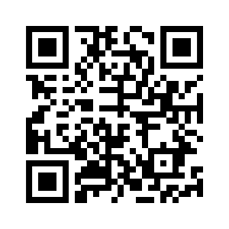
Thank you!
Reach out anytime (info in header below)
Resources
(slides and code)
@daveabrock
bit.ly/azure-search-talk

